Slide 1
Cognitive Processes
Week 5
Human Computer Interaction
CS-411

Slide 2
In the Last Lecture
Cognition
Cognition Frameworks

Slide 3
In Today’s Lecture
Cognition In-Depth
Attention
Models of Attentions
Consequences
Memory
Models of Memory
Short Term Memory
Long Term Memory
Sensory Memory

Slide 4
Attention
Ability of mind to FOCUS ON ONE THING AT A TIME.
Our Surrounding can have multiple stimuli (competition).
We have limited capacity to process stimuli.
Selection and Focus is used for processing important stimulus.

Slide 5
Types of Attention
Visual Attention
Uses position and color.
Auditory Attention
Uses sound characteristics such as intensity, pitch, quality etc.
Haptic Attention??

Slide 6
Attention in Cognition
Attention
Encoding
Comparison
Response
Selection
Response
Execution
Memory
Human Information Processing Model

Slide 7
Models of Attention
Focused Attention
Single or Multiple Stimuli, Single Point of Attention
Example: Talking to someone
Divided Attention
Multiple Stimuli, Attempt Simultaneous focus
Example : Talking on phone while driving
Talking during Lecture ???????????

Slide 8
Another Classification
Voluntary Attention
Effort is made to focus
Involuntary Attention
Automatically focused
In an environment with multiple stimuli.
Involuntary Attention is Divided Attention?

Slide 9
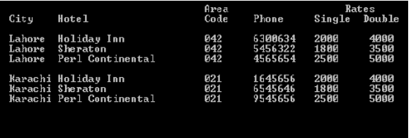
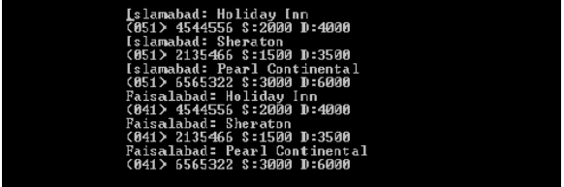

Slide 10
Factors Affecting Attention
Meaningfulness
Can any information be extracted?
Structure
Organized stimuli accelerates information processing.
Use of Colors
Highlight important objects, areas or text.
Use of Modals (Popups in Windows)
Visual Stimuli for directing attention.

Slide 11
Attention and Automatic Actions
Frequent activities become automatic.
Carried out without conscious attention.
User does not make conscious decision.
FACT!!!
Requiring confirmation does not necessarily reduce errors!

Slide 12
Consequences
Q: What are implications of understanding ‘Attention’?
A: An Interface that:
Is designed to focus attention at the right places.
Helps user with his/her task.
User must spend most of the time on task and not on interface.
User must be able to focus on what is required to do the task.
Does not create unnecessary distractions.
Structures/Organizes the task.

Slide 13
Consequences (contd)
A: A Good Interface:
Highlights important information.
Minimize Clutter.
Uses design elements for visual emphasis
Grouping elements using spacers
Dividing interface into sequenced elements.
Colors have meanings!

Slide 14
Lets test our knowledge
Notice anything?

Slide 15
Memory
Stores Knowledge.
Encoding, storing and recall.
May involve acting appropriately.
Involves Filter and Processing
We don’t remember everything.
We may remember something but not its detail.
Context is important.
“I think I have seen you somewhere….”

Slide 16
Memory
Recognizing objects Vs Recalling Objects
We recognize better than we recall.
Example: You may recognize someone but you may not remember where you met.
Recalling Images vs Words
We recall images better than words (Picture Superiority Effect)
Example: Define water filtration (Image vs Text)

Slide 17
A Model of Memory
Three memory stores
Sensory Memory
input buffer
visual or acoustic
Short Term Memory
‘scratchpad’ store
visual or acoustic
Long term memory
stores facts and meanings
semantically organized
Sensory memory
Short term memory
Long term memory

Slide 18
Revised Memory Model
Working memory is a subset of LTM.
Items are semantically linked.
Items in working memory are activated.
Activation is supplied from links in LTM and from sensory input.
Analogy: Data Storage?
Sensory memory
Working memory
Long term memory

Slide 19
Revised Human Processor Model and Related Memory
Visual Stimulus
Perceptual processor
Visual image store
Auditory image store
Motor processor
Working memory
Cognitive Processor
Long term memory

Slide 20
Sensory Memory/ Perceptual Store
Visual and auditory impressions
visuospatial sketchpad, phonological loop
Very brief, but real representation of what was perceived
Details decay quickly (~.5 sec)
Rehearsal prevents decay

Slide 21
Sensory Memory/ Perceptual Store
Buffers for stimuli received through senses
iconic memory: visual stimuli
echoic memory: aural stimuli
haptic memory: tactile stimuli
Examples
“sparkler” trail, finger moving
Surround Sound
Continuously overwritten

Slide 22
Short Term Memory
Scratch-pad for temporary recall
Rapid access ~ 70ms, decay ~ 15-30 sec,
Limited capacity - 7± 2 chunks (Miller’s Theory)
(“closure”) = inbuilt desire to chunk information
New info can interfere with old info
Tends to get flushed after closure.
ATM machine provides ATM card to user before cash

Slide 23
Short Term Memory
Can be transferred to long term memory
Chunking
03223278865 vs 0322 327 8865
Which one is easier to remember?
Repetition
Rhyming

Slide 24
The Miller Theory Dilemma
Designers often misinterpret what 7± 2 means.
Present only 7 options on a menu
Display only 7 icons on a tool bar
Have no more than 7 bullets in a list
Place only 7 items on a pull down menu
Why is it not always correct?

Slide 25
The Miller Theory Dilemma
Answer:
People can scan lists of bullets, tabs, menu items till they see the one they want
Sometimes a small number of items is good design
Task and available screen estate are important factors.

Slide 26
Serial Position Effect
265397620853
Recency Effect
Can you recall the last digits?
Ability to recall last digits is better than others.
Primacy Effect
Can you recall the first digits?
First digits are easier to recall because of LTM.

Slide 27
Long Term Memory
Repository for all our knowledge
slow access ~ 200 ms
slow decay, if any
huge or unlimited capacity
Organized as a network of connected chunks of knowledge
Knowledge moves between LTM and WORKING MEMORY by Activation.

Slide 28
Classification of LTM
Episodic memory
Events & experiences in serial form
Example: Remembering an event from childhood
Semantic memory
Structured record of facts, concepts & skills
How we make sense of things.
Has been modeled as a network, frames & scripts (like record structures)
Represents relationships between bits of information
Supports inference

Slide 29
Semantic Model - Network
Inheritance – child nodes inherit properties of parent nodes
Relationships - between bits of information explicit
Supports inference through inheritance

Slide 30
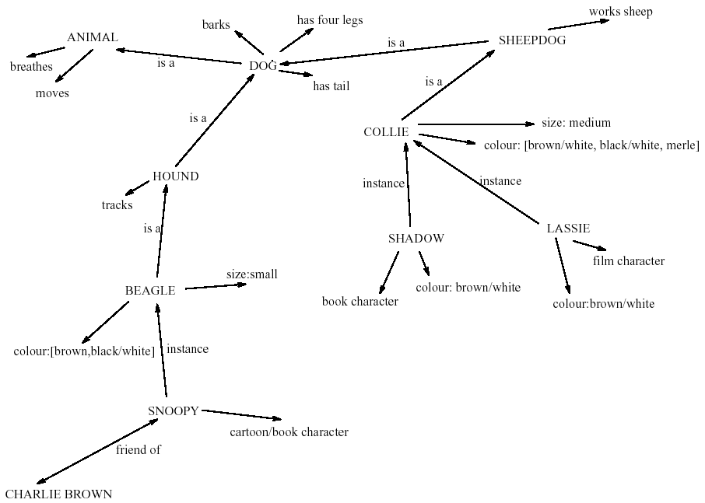
Semantic Model - Network

Slide 31
Semantic Models- Frames
Information organized in data structures
Structure instantiated with values for instance of data
Can have actions associated with a slot.
DOG
Fixed
legs: 4
Default
diet: carnivorous
sound: bark
Variable
size: color
COLLIE
Fixed
breed of: DOG
type: sheepdog
Default
size: 65 cm
Variable
color

Slide 32
Semantic Models - Scripts
Script for a visit to the vet
Model of transparent information required to interpret situation
Has elements that can be instantiated with values for context
Entry conditions: dog ill
vet open
owner has money
Result: dog better
owner poorer
vet richer
Props: examination table
medicine
instruments
Roles: vet examines
diagnoses
treats
owner brings dog in
pays
takes dog out
Scenes: arriving at reception
waiting in room
examination
paying
Tracks: dog needs medicine
dog needs operation

Slide 33
Consequences
Q: What are implications of understanding ‘Memory’?
A: An Interface that:
Does not overload users’ memories.
Has interfaces that promote recognition rather than recall by using menus, icons, and consistently placed objects.
Allows users to access information again.
Saved Data, Emailed form etc.

Slide 34
What can We Deduce?
Minimize the need for excessive memory usage.
Presenting the information in an organized, structured, stimulating and meaningful way.
Placing all required information for task performance in close physical proximity.
Giving the user control over the pace of information presentation.

Slide 35
Thank you
Questions?

